Slide 1
DevMountain Full Stack Developer Bootcamp
-Final Capstone Project-
Consulting App <Contract Central>
Created by: Lan Kostrikin
Instructed by: Robert Davis

Slide 2

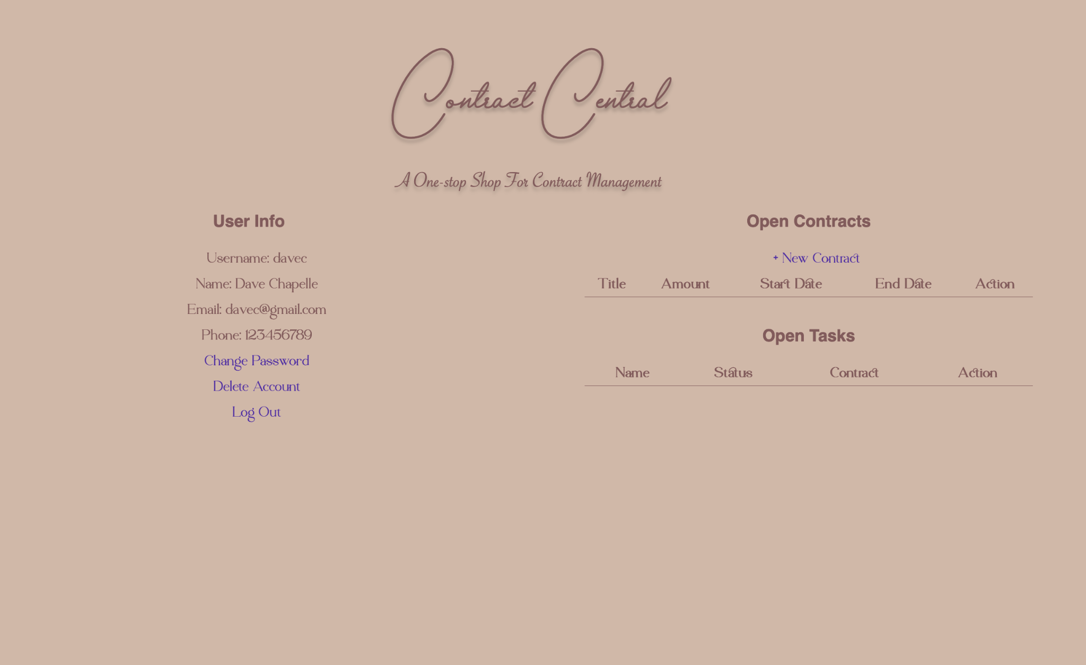
Developer Intro
Website Intro
Lan Kostrikin at DevMountain (4 months learning experience)
Current practice: JS, CSS, html, Java
Goal: Master skill of Java/Python
Previous career: Actuary (ASA), Accountant(CPA), IS Auditor(CISA), Cybersecurity Auditor (CISSP-WIP)
Mission Statement: To provide a central hub for freelance contractors to manage the contracts.
Time spent: Three(3) days.

Slide 3
Front End Features
Views:
There are four(4) main views built into the site structure:
Login page
User register page
Main page: Include the REST api requests
Change password page
Technology used:
HTML
CSS

Slide 4
Back End Features
Database:
3 data tables w/ preload data: Users; Contracts; Tasks
One to many relationship
Connected to a postgres server
Java tech:
Spring-boot-starter-data-jpa: Connect database to backend
Spring-boot-starter-web: Connect backend to frontend
Spring-boot-starter-thymeleaf: Dynamic HTML
Three (3) interfaces

Slide 5
Thank you!
website code repo
Refer to README.md to play around with the website

